Slide 1
Significance of Wintertime Cloud Cover on Arctic Sea Ice Variability
Aaron Letterly (CIMSS), Jeff Key (NOAA/NESDIS)

Slide 2
Project Introduction
Cloud forcing: difference in radiative components of an energy budget between clear-sky and all-sky conditions
Future effect of cloud forcing over the arctic is uncertain
80-year simulation, CMIPP Intermodel Spread¹

Slide 3
Motivation
Could clouds be responsible for abrupt swings in ice area/concentration?
Do clouds have an instantaneous effect on sea ice, or is it “buried” in the energy budget?
a) MERRA surface cloud forcing anomaly, January 2012
b) Cryosat-2 ice thickness difference, December 2012- March 2013 ²

Slide 4
Goals
1.Determine cloud forcing’s role as an energetic contributor to ice variability
2.Assess cloud forcing’s ability to predict future anomalous ice conditions

Slide 5
Data and Methods
APP-x Product
Swath-to-grid transfer
Re-gridded APP-x monthly means
Passive Microwave Sea Ice Concentrations
Swath-to-grid transfer
Re-gridded ice concentration product
ERA-Interim Output
Swath-to-grid transfer
Re-gridded model output
Intercomparison

Slide 6
Cloud Contribution
Longwave cloud forcing is prominent in the arctic energy budget
Annually maintains a surface warming effect of 35 W/m²
Beaufort Sea

Slide 7
Modeled Contribution
ERA-Interim Reanalysis Output
Surface longwave cloud forcing anomaly, monthly mean, January 1982

Slide 8
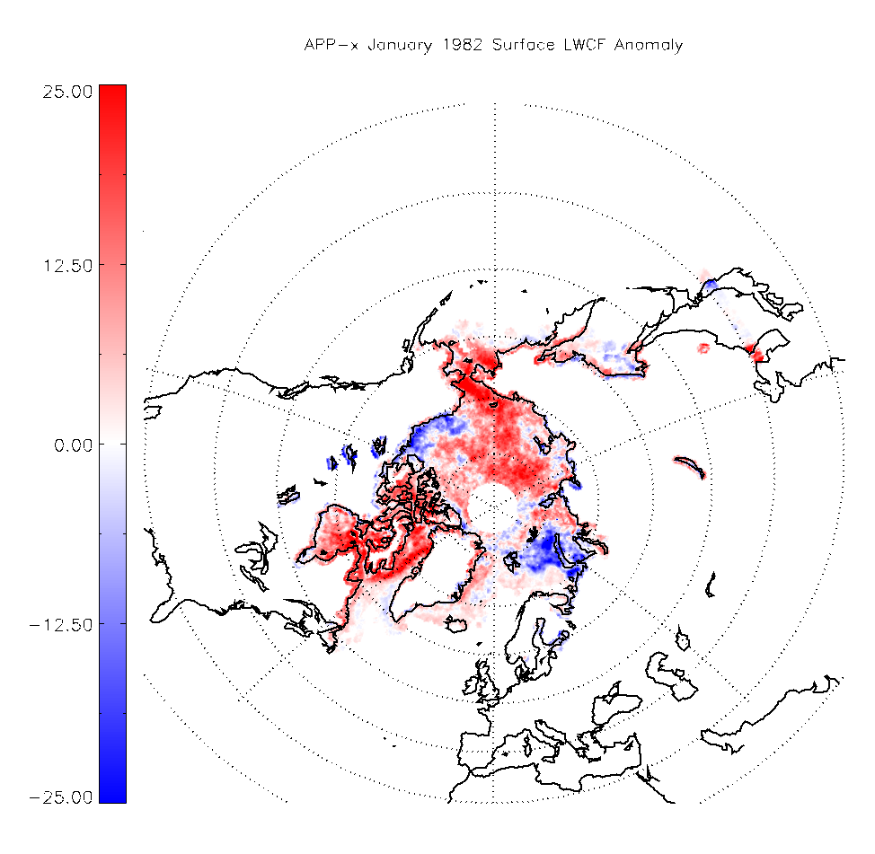
Remotely-Sensed Contribution
APP-x 0400 Monthly Mean Product
Surface longwave cloud forcing anomaly, January 1982

Slide 9
Intercomparison
Blue pixels: stronger negative APP-x cloud forcing
Red pixels: stronger positive APP-x cloud forcing
Green pixels: small differences between methods

Slide 10
Analysis
Does anomalous cloud forcing have an appreciable effect on ice growth?
Use models to estimate theoretical ice growth from specific years
Simulated thickness changes due to LWCF anomaly, 2013²

Slide 11
Analysis
Areal correlations appear significant
Marginal ice areas are strongly affected

Slide 12
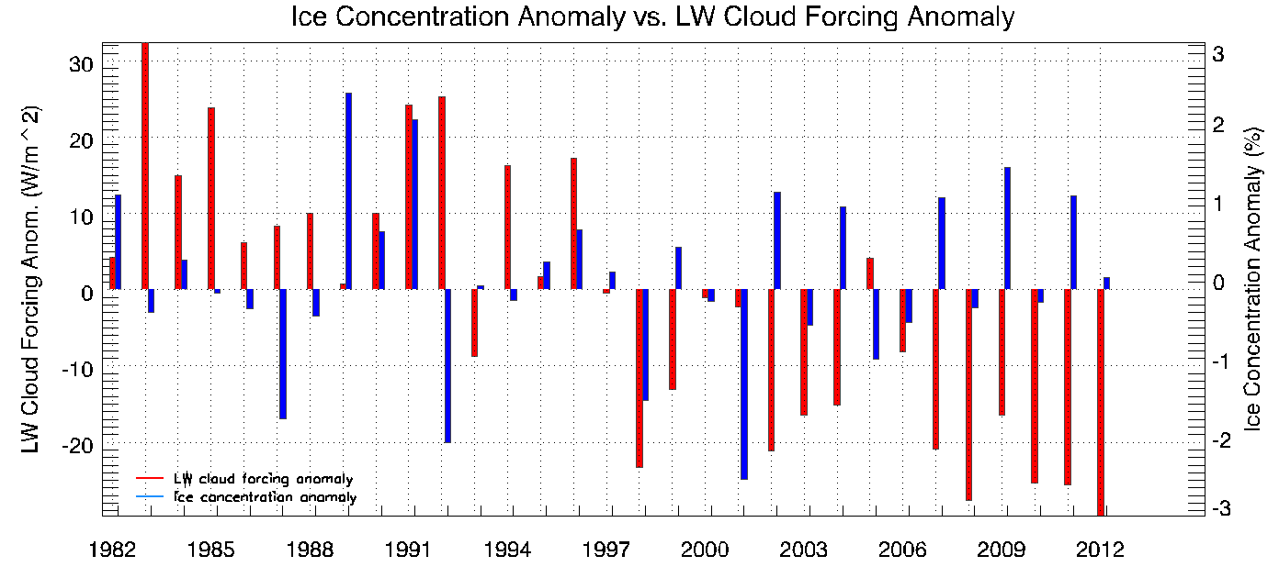
Prediction
Beaufort Sea, lagged correlation timeseries
2000-2013 correlation: -.56

Slide 13
Conclusions
LW cloud forcing can contriubte to significant thermodynamic forcing on thin sea ice
LW cloud forcing can be a reasonable predictor of future, marginal sea ice concentration

Slide 14
References
Pithan, F., and T. Mauritsen, 2014: Arctic Amplification dominated by temperature feedbacks in contemporary climate models. Nature Geoscience, 7, 181-184, doi: 10.1038/NGEO2071.
Liu, Y., and J. Key, 2014: Less Winter Cloud Aids Summer 2013 Arctic Sea Ice Return from 2012 Minimum. Environmental Research Letters, 4, doi: 10.1088/1748-9326/9/4/044002.

